Slide 1
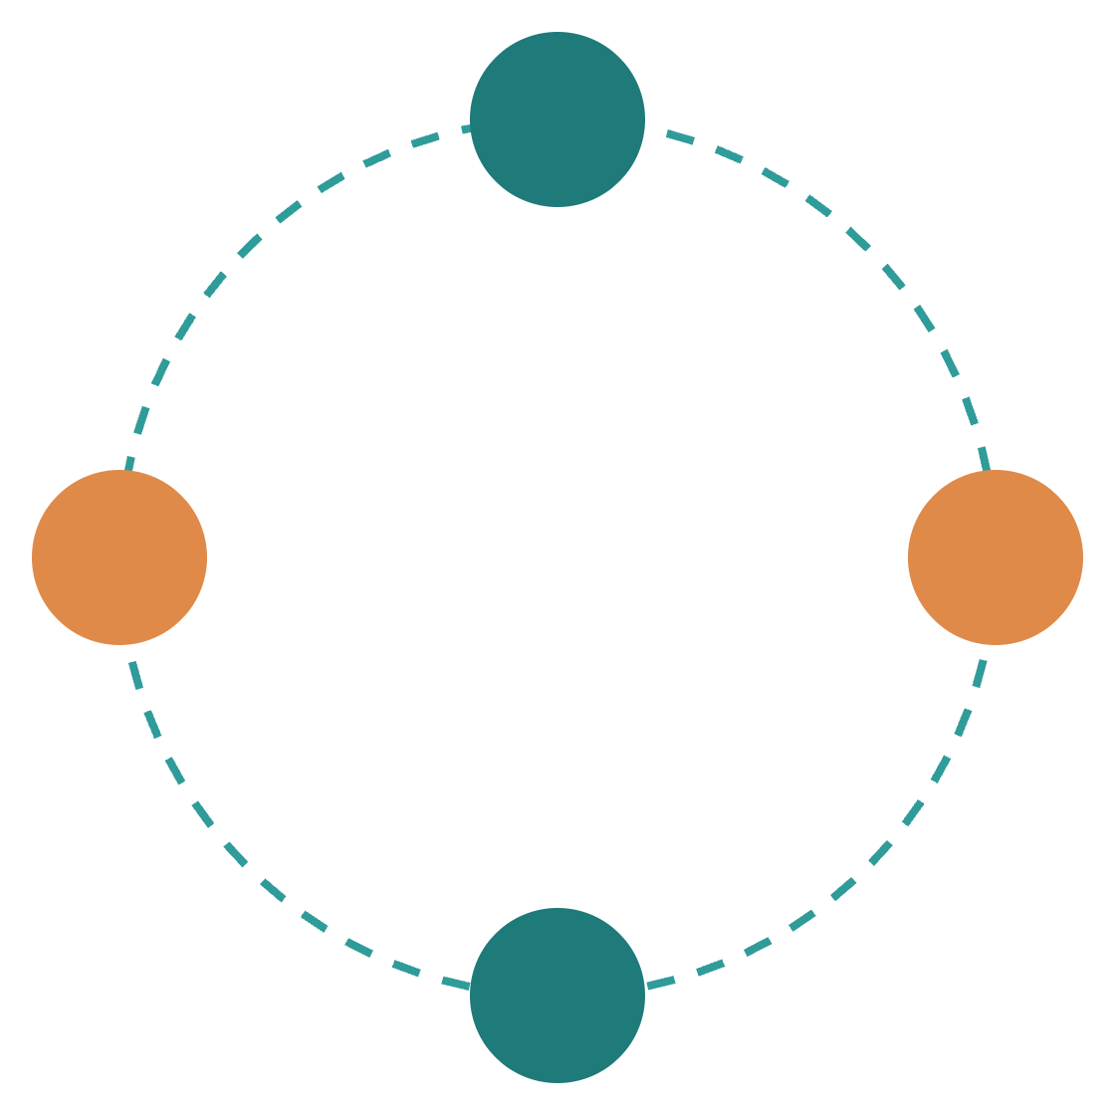
AI Agents & Agentic AI
PLAIN-LANGUAGE EDITION
P
O
R
The concepts in plain language, then one worked example
A
Notes:
[about 1 min] Good morning, everyone. "Agent" and "agentic" are two of the most overused words in our industry, so today I want to make them clear. We'll do this in two parts. First the concepts, in plain language: what an agent is, what it is built from, what "agentic" really means, and what it takes to run one safely. Then, at the end, one worked example from fund operations that brings all of it together. The diagrams are adapted from the aiagent.org engineering tutorials and credited on each slide.

Slide 2
A chatbot answers. An agent gets the job done.
FOUNDATIONS
CHATBOT
AI AGENT
Generates text
Acts
One prompt in, one answer out. Any follow-up work is yours.
Works toward a goal over many steps, using tools, until the task is done or a stop condition is reached.
FOUR ABILITIES MAKE THE DIFFERENCE
Reasoning
Memory
Tool use
Planning
Reads the situation and chooses the next step
Keeps track of the task and of the past
Calls APIs, runs code, searches, queries data
Breaks a big goal into smaller steps
Notes:
[about 1 min] The source tutorial puts the difference in one line: a language model generates text, an agent acts. A chatbot takes one prompt and gives one answer. Any follow-up work is yours. An agent works toward a goal over many steps, using tools, until the task is done or it reaches a stop condition. Four abilities make that possible. Reasoning: reading the situation and choosing the next step. Memory: keeping track of the task and of the past. Tool use: calling APIs, running code, searching, querying data. And planning: breaking a big goal into smaller steps. Take one away and you are back to a chatbot.

Slide 3






Four stages, each adding one ability
FOUNDATIONS
Chatbot
LLM + Tools
AI Agent
Multi-Agent
The starting point
+ tool calling
+ looping and memory
+ collaboration
Answers one question at a time
Can look something up or call a system
Keeps going until the goal is met
Specialist agents work as a team
The last step is the one to justify. Start with a single agent and add another agent only when one clearly can’t handle the task.
Notes:
[about 1 min] Think of these four stages as a ladder, where each rung adds exactly one ability. A chatbot answers one question at a time. Add tool calling, and it can look something up or call a system, but it does that once and stops. Add a loop and memory, and you have an agent: it keeps going until the goal is met. Add collaboration, and you have a multi-agent system, where specialist agents work as a team. The last step is the one you have to justify. More agents means more cost and more ways to fail, so start with one.

Slide 4




How an agent works: look, think, do, check
FOUNDATIONS
1 · Perceive
2 · Reason
3 · Act
4 · Observe
Takes in the request, tool results, files and events
The model weighs what it knows and picks the next step
Calls a tool, saves a note or sends a message
Looks at the result and asks: is the goal met?
↺ Not done? Go round again, until the goal is met or a stop condition fires
An agent that never decides it is finished keeps spending. Cap the steps, the budget and the time.
Notes:
[about 1 min] Every agent, however clever it looks, runs this same loop: look, think, do, check. The formal names are perceive, reason, act and observe. Perceive: it takes in the request, tool results, files and events. Reason: the model weighs what it knows and picks the next step. Act: it calls a tool, saves a note or sends a message. Observe: it looks at the result and asks whether the goal is met. If not, it goes round again. That loop is the power of an agent and also its biggest risk. An agent that never decides it's finished just keeps spending, so we always cap the steps, the budget and the time. We'll see this loop run on a real case at the end.

Slide 5
What’s inside an agent
Task input
Perception
Long-term memory: the filing cabinet
Goal · question · event
Text, images, audio, files
Semantic — facts and documents
Context window (short-term memory): its desk right now
Episodic — past sessions
System prompt
Retrieved facts
Chat history
Tool outputs
Procedural — saved workflows
The reasoning brain (LLM)
User/entity — preferences
Reads the context and decides the next step
Planning
Memory write
Breaks the goal into steps
Saves useful facts for later
Tools it may use (through MCP or APIs)
Safety & guardrails
Web search
Code
Database
Files
APIs
Sub-agent
Checks, sandbox, human approval
Observe & decide
Final output
Observability
Done? If not, ↺ loop
Answer · report · action
Traces, logs, evals, token usage
Notes:
[about 1.5 min] This is the reference architecture from the source. Read it top to bottom. A task comes in and the perception layer turns it into something the model can work with. Everything the agent is working with sits in the context window. Think of it as its desk: its instructions, retrieved facts, the conversation so far and the results of its tool calls. The desk is small, which is why memory matters. The LLM is the reasoning brain. It plans the steps and saves useful facts for later. It acts through tools, then checks: done? If not, loop. On the right is what surrounds it. Long-term memory is the filing cabinet. And two layers that are not optional for us: guardrails and observability.

Slide 6
Memory: four kinds, like a person at work
BUILDING BLOCKS
Type | It is like… | What it holds | Lasts
Working | The papers on your desk | The current message and tool outputs | Seconds
Episodic | Your diary | Records of past events and interactions | Days to weeks
Semantic | The reference manual | Lasting facts about the user and the domain | Permanent
Procedural | Know-how | Learned skills and routines | Evolving
Storing is easy; recalling the right thing is hard. One framework, Mem0, ranks memories by relevance (50%), recency (30%) and importance (20%), and updates a fact when it changes.
Notes:
[about 1 min] Agent memory comes in four kinds, and they map onto how a person works. Working memory is the papers on your desk: the current message and tool outputs, gone in seconds. Episodic memory is your diary: records of past events. Semantic memory is the reference manual: lasting facts about the user and the domain. Procedural memory is know-how: learned skills and routines. Storing is the easy part; recalling the right thing is hard. One framework, Mem0, ranks memories half on relevance, thirty percent on recency and twenty percent on importance, and updates a fact when it changes. For long-running work, memory has to be designed.

Slide 7
RAG: look it up first, then answer
BUILDING BLOCKS
Done once, when documents are loaded
Done for every question
① Ingest & chunk
② Embed
③ Index
④ Retrieve
⑤ Generate
Split documents into passages
Give each passage a meaning fingerprint
Store them in a searchable library
Find the passages closest to the question
Answer from those passages only
Why it matters: answers are grounded in your own documents. Fewer hallucinations, and access to private or current data without retraining the model.
Notes:
[about 1 min] RAG stands for retrieval-augmented generation. In plain words: look it up first, then answer. The pipeline has five steps in two halves. The first three happen once, when documents are loaded: split them into passages, give each passage a "meaning fingerprint", which engineers call an embedding, and store them in a searchable library, a vector database. The last two happen for every question: find the closest passages, then answer from those passages only. Why it matters: answers are grounded in your own documents. That means fewer hallucinations, and access to private or current data without retraining the model.

Slide 8
Four ways an agent thinks
BUILDING BLOCKS
ReAct: think, do, look, repeat
Plan-and-execute: checklist first
Decides one step at a time, based on what it just saw. Simple and easy to audit.
Writes the whole plan, then works down it. Suits long, multi-stage work.
Reflection: check your own work
Context engineering: a tidy desk
Drafts, critiques the draft, then revises. Fewer errors, more calls.
Gives the model only what this step needs. More context is not better context.
Also in the toolbox: Chain-of-Thought (show the working) and Tree of Thought (try several routes, keep the best).
Notes:
[about 1 min] You'll hear these names from vendors and frameworks, so here they are in plain words. ReAct: think, do, look, repeat. The agent decides one step at a time. Plan-and-execute: write the checklist first, then work down it. Reflection: draft, check your own work, revise. And context engineering: keep the desk tidy and give the model only what this step needs. They combine. A real agent might plan up front, use ReAct inside each step and reflect before it hands over.

Slide 9



MCP: one standard plug for every system
BUILDING BLOCKS
“What can you do?”
MCP server
The agent app
Resources — read-only data
The system
Asks each server what it offers, then calls what it needs
A database, file store or API
Tools — actions it can take
(the MCP client)
“Then do this.”
tools/list · tools/call
Prompts — reusable templates
WHY IT MATTERS
WHO IS IN CONTROL
Build a connector once and any compliant agent can use it. Without a standard, every agent needs its own custom link to every system.
The agent app. It sets the limits and asks for approval; servers hold no model keys.
Notes:
[about 1 min] An agent is only useful if it can reach our systems. MCP, the Model Context Protocol, is the emerging standard plug for that. On the left is the agent app, formally the MCP client. On the right is an MCP server, a small adapter in front of one system. The app asks, "what can you do?", the server answers, and the app says, "do this." A server offers three things: resources, which are read-only data; tools, which are actions; and prompts, which are reusable templates. Why it matters: build a connector once and any compliant agent can use it. And the agent app stays in control; servers never hold the model's keys.

Slide 10
Three terms that get mixed up
AGENTIC & MULTI-AGENT
A COMPONENT
A PROPERTY
A STRUCTURE
AI Agent
Agentic AI
Multi-Agent
Like one capable analyst
How much you let them decide alone
Like a team with roles
A single model running the loop. Mature and lowest cost, but one point of failure.
How far the system plans and corrects itself. More autonomy needs stronger guardrails.
Specialised agents coordinating. Parallel and flexible, but the most complex and costly.
So “agentic AI” is two separate decisions: how much autonomy, and how many agents.
Notes:
[about 1 min] Three terms get used as if they mean the same thing. They don't. An AI agent is a component: think of one capable analyst. Agentic AI is a property: how much you let that analyst decide alone. Multi-agent is a structure: a team with roles. These are independent. You can have one very autonomous agent, or a team of tightly scripted ones. So when someone says "agentic AI", ask two separate questions: how much autonomy, and how many agents?

Slide 11
Autonomy is a dial with five settings
AGENTIC & MULTI-AGENT
Scripted pipeline
Fully autonomous
L1
L2
L3
L4
L5
Rule-based / assisted
Tool-using assistant
Task-oriented autonomy
Adaptive / workflow autonomy
Fully autonomous ⚠
Follows fixed rules; a person drives
Uses tools when asked, within a narrow brief
Given a task, works out the steps itself
Acts with no human involved. Experimental.
Runs whole workflows and adapts to change
The further right you turn it, the more controls you need. High autonomy with light controls is a reliability and safety liability.
Notes:
[about 1 min] If "agentic" is a property, we can measure it. Think of a dial with five settings. At L1 the system follows fixed rules and a person drives. At L2 it uses tools when asked. At L3 you give it a task and it works out the steps. At L4 it runs whole workflows and adapts. L5 is full autonomy, which the source flags as experimental. The further right you turn the dial, the more controls you need. So agree the target setting for each use case before any design work starts.

Slide 12




A team of agents: one lead, several specialists
AGENTIC & MULTI-AGENT
Orchestrator: the team lead
Splits the goal, tracks progress, decides who may do what
Researcher
Writer
Coder
Judge
Searches and retrieves
Produces the content
Writes and tests code
Checks quality before release
Shared memory
Tool registry
Observability
Notes:
[about 1 min] When one agent genuinely isn't enough, this is the most common shape in production: one lead and a few specialists. The formal name is orchestrator and workers. The orchestrator splits the goal, tracks progress and decides who may do what. Under it are specialists: a researcher, a writer, a coder and a judge. Notice the judge is separate from the writer. That's the four-eyes principle applied to AI: a model is too ready to approve its own work. Along the bottom is what they share: memory, an approved list of tools, and one activity log. It's popular because it is reliable and auditable.

Slide 13
Four ways to organise a team of agents
AGENTIC & MULTI-AGENT
Pattern | Think of it as | Best for | Watch out for
Hierarchical | A team lead handing out work | Regulated, auditable work: insurance, legal, engineering | The lead becomes a bottleneck
Pipeline | An assembly line | ETL, content production, report generation | Nothing runs in parallel
Peer-to-peer | Colleagues messaging each other directly | Work that crosses teams or organisations | Hard to observe and govern
Swarm | Many explorers at once | Open-ended research, brainstorming, simulation | Unpredictable, hard to audit
Start with a single agent. Add more only when one clearly can’t do the job.
Notes:
[about 1 min] There are four main ways to organise a team of agents. Hierarchical is a team lead handing out work: reliable and auditable. Pipeline is an assembly line: predictable, but nothing runs in parallel. Peer-to-peer is colleagues messaging each other directly: flexible, but hard to observe and govern. Swarm is many explorers at once: good for open-ended research, but unpredictable. And the same advice as before: start with a single agent, and add more only when one clearly can't do the job.

Slide 14
How agents talk to each other (A2A)
AGENTIC & MULTI-AGENT
Every message carries
ONE MESSAGE BETWEEN AGENTS
who sent it and who it is for
a conversation reference (correlation ID)
a timestamp
a type: request, propose, inform, accept or refuse, failure
{
"sender": "planner",
"receiver": "researcher",
"correlation_id": "…",
"timestamp": "…",
"type": "REQUEST"
}
The reference lets you replay the whole conversation for audit.
MCP connects an agent to systems. A2A connects agents to each other.
Notes:
[about 1 min] If agents work as a team, they need a disciplined way to talk. That's A2A, agent-to-agent communication. Every message is a small envelope: who sent it, who it's for, a conversation reference, a timestamp and a type. The types are a short fixed vocabulary: request, propose, inform, accept or refuse, and failure. That last one matters: a good agent says "I couldn't do it" instead of guessing. The conversation reference lets you replay the whole exchange afterwards for audit. One line to remember: MCP connects an agent to systems. A2A connects agents to each other.

Slide 15



Guardrails: build them in, don’t just ask
PRODUCTION
The risk is prompt injection: instructions hidden inside a document, email or web page that the agent reads. The defence is to split reading from acting.
Untrusted input
1 · Reader model
2 · Schema check
3 · Actor model
4 · Pre-flight check
Emails, documents, web pages
Reads the content. Has no tools. Outputs set fields only.
Keeps the expected fields. Drops free text.
Holds the tools. Never sees the raw text.
Blocks unsafe calls before any tool runs.
10–25%
The rule: the model that reads untrusted content must never be the one that holds the tools.
failure rate cited for defences that only tell the model to “ignore instructions in documents”
Notes:
[about 1.5 min] Now to running agents safely, starting with security. The risk is prompt injection: instructions hidden inside a document, email or web page that the agent reads. If the model that reads that content can also take actions, it can be tricked. Telling the model to "ignore instructions in documents" is not enough. The source cites a ten to twenty-five percent failure rate for that kind of defence under attack. The real fix is structural. A reader model reads the untrusted content. It has no tools and outputs set fields only. A schema check keeps the expected fields and drops free text. The actor model, which holds the tools, never sees the raw text. And a pre-flight check blocks unsafe calls before any tool runs. The rule: the model that reads untrusted content must never be the one that holds the tools.

Slide 16
A person approves anything that matters
PRODUCTION
1 Draft. The agent does the work and prepares the action.
What the supervisor sees
2 Ask. It posts an approval card; each button carries a signed token.
Agent action pending approval
3 Pause. Work stops before the critical step; its state is saved.
A short summary of what the agent wants to do.
4 Decide. A supervisor approves or rejects; the token is verified.
The evidence behind it, and the expected impact.
5 Resume or escalate. No answer in about two hours goes to on-call.
Approve action
Reject
6 Audit. Who, when, what and the outcome go into an append-only log.
The agent does the work. A named person owns the decision.
Notes:
[about 1 min] Some actions should never be fully automated: deleting data, sending something external, moving money. For those, a person approves. One, the agent prepares the action. Two, it posts an approval card with a signed token, so an approval can't be forged. Three, the work pauses before the critical step and its state is saved. Four, a supervisor approves or rejects. Five, it resumes where it stopped, or escalates if nobody answers in about two hours. Six, everything goes into an append-only audit log. The agent does the work. A named person owns the decision.

Slide 17
Testing an agent: three questions
PRODUCTION
LAYER 3 · SEMANTIC (LLM-AS-A-JUDGE)
50–100
Is the answer right?
realistic test cases with known answers, including edge cases
A second, independent model grades the answer for accuracy, completeness and safety.
~20
LAYER 2 · TRAJECTORY & EFFICIENCY
Did it work sensibly?
of them re-run on every change to the agent
Tools called in a logical order, no loops, finished in a reasonable number of steps.
0.8 / 0.9
LAYER 1 · UNIT & SCHEMA
example pass marks: right tools used / answer faithful to the data
Is the output well-formed?
The output has the required structure, and every tool it called actually exists.
Notes:
[about 1 min] How do we know an agent is any good, and stays good after we change it? We test with three questions. Read from the bottom up. Layer one: is the output well-formed? Cheap and automatic. Layer two: did it work sensibly? That tests the route, not just the destination. Layer three: is the answer right? A second, independent model grades it. To run this, build fifty to a hundred test cases with known answers, re-run about twenty on every change and the full set before release, and set explicit pass marks. The numbers shown are the examples from the source.

Slide 18
What goes wrong, layer by layer
PRODUCTION
Layer | Typical failure
Perception | Missing input types, such as scanned documents
Short-term memory | Context overflow: early details get lost
Long-term memory | Stale data, irrelevant retrieval
Planning | Infinite loops, invented plans
Tool layer | Tool timeouts, invalid arguments
Safety | Prompt injection, cost overruns
Observability | Silent failures, undetected regressions
Controls: step and budget limits, timeouts, repeated-call detection, a trace of every step, and an agent that says “I couldn’t get it” when a tool fails.
Notes:
[about 1 min] Every layer we've discussed has its own typical way of failing. Perception misses an input type. Short-term memory overflows and loses early details. Long-term memory serves stale facts. Planning loops or invents a plan. Tools time out. Safety fails through prompt injection or runaway cost. And the most dangerous is observability: silent failures nobody notices. The controls are familiar engineering: limits, timeouts, detecting repetition, a trace of every step, and an agent that says "I couldn't get it" when a tool fails. That's the theory. Now let's see all of it on one case.

Slide 19
The case: a NAV break at 07:40
WORKED EXAMPLE
Fund A’s NAV is up 1.8%. Its benchmark is up 0.2%. The tolerance is 0.5%. Someone has to explain why before the NAV is released.
WHAT AN ANALYST DOES TODAY
Check prices
Check FX rates
Corporate actions
Trades & cash
Write the note
The next three slides put an AI agent on this case, using the concepts we have just covered.
Notes:
[about 1 min] Now let's put it all together on one case from fund operations. It's 07:40. Fund A's NAV has moved 1.8 percent, the benchmark has moved 0.2, and the tolerance is half a percent. That's a break, and somebody has to explain it before the NAV goes out. Today an analyst works through a checklist: prices, FX rates, corporate actions, trades and cash, and then writes the explanation. Over the next three slides we'll put an AI agent on this case. The fund and the numbers are made up for illustration.

Slide 20
The agent’s loop on this case
WORKED EXAMPLE
1 · Perceive
2 · Reason
3 · Act
4 · Observe
Sees the alert: Fund A is up 1.8%, tolerance is 0.5%
“Start with the biggest holdings and check their prices”
Queries the pricing feed for the top positions
Bond X’s price is unchanged for three days. Explained yet? Not fully.
↺ Round two: compares a second price vendor. Round three: cause confirmed, drafts the note.
Three rounds of the same loop take it from an alert to a draft break note, ready for a person to review.
Notes:
[about 1.5 min] Here is the loop from earlier, running on our case. Perceive: the agent sees the alert, Fund A up 1.8 percent against a half-percent tolerance. Reason: it decides to start with the biggest holdings and check their prices. Act: it queries the pricing feed. Observe: Bond X's price hasn't changed in three days. Is the break explained? Not fully, so it goes round again. Round two, it compares a second price vendor and finds a different price. Round three, the cause is confirmed and it drafts the note. Three rounds of the same simple loop take it from an alert to a draft break note, ready for a person to review.

Slide 21
Each concept, applied to this case
WORKED EXAMPLE
Concept | On the NAV break
Tools (via MCP) | Pricing feed, FX rates and the ledger, all read-only
Memory | Recalls that Bond X had a stale price last month too
Retrieval (RAG) | Looks up Fund A’s tolerance and the break runbook
Reasoning pattern | Plans the checks first, then re-reads its draft against the numbers
Autonomy level | L3: it investigates and drafts; a person reviews and decides
Multi-agent? | Not needed. One agent can handle one break
Nothing here is exotic: one agent, a few read-only tools, and a clear limit on what it may decide.
Illustrative example written for this deck. Fund, securities and figures are fictional.
Notes:
[about 1.5 min] This slide maps the concepts from the first part onto the case. Tools: the agent reaches the pricing feed, FX rates and the ledger through standard connectors, all read-only. Memory: it recalls that Bond X had a stale price last month too, which is why it checks that first. Retrieval: it looks up Fund A's tolerance and the break runbook, so it works from our rules, not general knowledge. Reasoning pattern: it plans the checks first, then re-reads its draft against the numbers. Autonomy: this is level three. It investigates and drafts; a person reviews and decides. And multi-agent? Not needed. One agent can handle one break. Notice that nothing here is exotic: one agent, a few read-only tools, and a clear limit on what it may decide.

Slide 22
The controls around this case
WORKED EXAMPLE
Guardrail
What the supervisor sees
It can read the ledger but cannot post to it.
Agent action pending approval
Human approval
The price correction waits for a supervisor.
Correct the price of Bond X in Fund A for 9 Nov, from vendor A to vendor B.
Evaluation
Evidence: vendor A price unchanged for three days. Estimated NAV impact: −1.6%.
Before release, it is replayed on past breaks with known causes.
Observability
Approve action
Reject
Every query and decision is logged and can be replayed.
The agent does the investigation. A named person owns the decision.
Notes:
[about 1.5 min] Finally, the controls from the last part, applied to the case. Guardrail: the agent can read the ledger but cannot post to it. Human approval: the price correction waits for a supervisor. On the right is what that supervisor sees: what the agent wants to do, the evidence, the estimated impact, and two buttons. Evaluation: before the agent is released, it is replayed on past breaks where we already know the cause. Observability: every query and decision is logged and can be replayed for audit. So the agent does the investigation, and a named person owns the decision. That's the whole picture: the concepts from the first part, working together on one ordinary morning.

Slide 23
Five principles to take away
TAKEAWAYS
01
Start with one agent.
Add a team of agents only when one clearly can’t cope.
02
Choose the autonomy level on purpose.
Agree the setting per use case, and scale the controls with it.
03
Separate reading from acting.
The model that reads untrusted content never holds the tools.
04
A person approves what can’t be undone.
High-stakes actions wait for a named approver, with an audit log.
05
Test and trace before release.
Evals and traces are release gates, not afterthoughts.
Notes:
[about 1 min] Let me close with five principles. One: start with one agent. Two: choose the autonomy level on purpose, and scale the controls with it. Three: separate reading from acting. Four: a person approves what can't be undone. Five: test and trace before release. You saw all five in the worked example. If we hold to them, we can move quickly with agents and still stand behind every action they take. Thank you. I'm happy to take questions, and the next slide has a plain-language glossary.

Slide 24
The jargon in plain words
REFERENCE
Term | In plain words
LLM | The language model. It predicts text and does nothing on its own.
Agent | An LLM in a loop with tools, working toward a goal.
Agentic | How much the system decides and corrects by itself.
Context window | What the model can see right now: its desk.
RAG | Look it up first, then answer from what was found.
MCP | A standard plug between agents and systems.
A2A | A standard way for agents to message each other.
Guardrail | A control that limits what the agent can read or do.
Human-in-the-loop | A person approves before a high-stakes action.
Eval | A repeatable test of agent quality, run before release.
Notes:
[Backup slide for Q&A] A plain-language glossary of the terms used today. Use it if a question shows a term didn't land, or leave it up while people ask questions.

